Slide 1
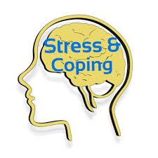
CLASS INTRODUCTION
STRESS & COPING
FEM 3105

Slide 2
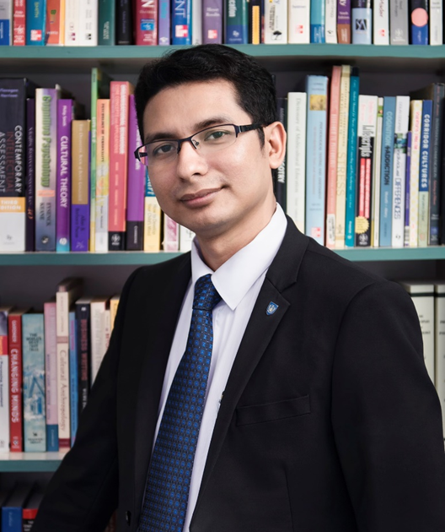
DR. MOHD NAJMI BIN DAUD
B.HSc, M.HSc (Clinical Psychology), IIUM, PhD (Psychology), Massey, NZ
E-mail:
najmi@upm.edu.my
najmi1108@yahoo.com
Room:
Room 3,
Department of Human Development and
Family Studies,
Faculty of Human Ecology, UPM

Slide 3


Class Schedule and Consultation Hours
Class Time:
Wednesday: 12.00 pm – 2.00 pm
Friday: 9.00 am – 10.00 am
Consultation Hours:
Tuesday & Thursday
10.00 am - 1.00 pm
(Room 3, JPMPK) or online (depends of the situation)

Slide 4
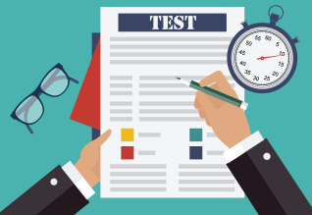
ASSESSMENT
Assignment & Test = 60%
- Test (20%)
- Report writing (20%)
- Presentation (10%)
- Quiz (10%)
Final examination = 40%

Slide 5
Important dates!!!
9th April 2021 (FRIDAY)
Deadline for topic selection
20th June 2021
Deadline for assignment submission
PRESENTATION
Week 13

Slide 6
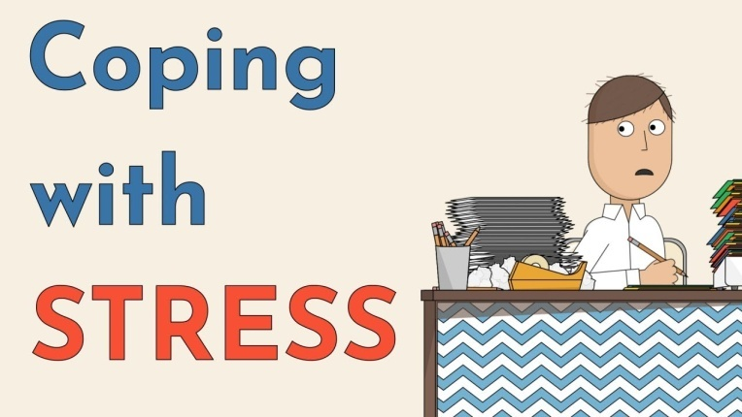
Synopsis FEM 3105
This course encompasses the examination of stress and coping among individuals. Stressors across the life span in various contexts, factors affecting stress levels, coping resources and strategies, holistic stress management technique, measurements of stress and coping and analysis of prevention programs related to stress reduction are also emphasized.

Slide 7

LEARNING OUTCOME
Students able to:
Able to explain the concepts, process and stress model of stress and coping (C3)
Elaborate the stressors, impact and coping strategies at various context over the life span. (C4, P2, LL, TS)
Analyze coping strategies and holistic stress management technique. (A3, CTPS)

Slide 8
COURSE CONTENT
1. Introduction and meaning of basic concepts
  Stress
  Coping
  Adjustment
2. Stressor and stress reaction
  Physiology
  Psychology
  Behavioural
  Benefit of stress response
3. Model of stress process, coping and adjustment
  Individual stress model
  Family stress model
4. Factors influencing stress tolerance: Individual stress model: Personal
  Personal coping resources
  Individual Perception and definition
  Individual Personality
  Self concept
  Locus of control
  Coping strategies

Slide 9
5. Factors influencing stress tolerance: External
  External coping resources
  Family characteristic
  Environment
  Support system
6. Life long stressor
  Social Expectation
  Schooling
  Work and stress
  Marriage and family
  Interpersonal relationship
7. Multiple coping strategies
  Cognitive
  Emotion
  Spiritual
  Communication
  Community/relationship
  Stress management

Slide 10
8. Holistic management technique
  Physical
  Cognitive
  Personal
  Sosio-emotion
  Spritual
9. Stress and coping measurement
  Analysis of instruments
  Issues related in measurement
  Research in related area
10. Preventive Programme
  Analysis of available programme
  Purpose of primer preventation
  Programme planning
  Development of preventive programme

Slide 11
REFERENCES :
Blonna, R. (2005). Coping with Stress in a Changing World (3rd Edition). London: McGraw-Hill.
Greenberg, S. (2002). Comprehensive Stress Management (8th Edition). London: McGrawHill.
Hatta Siddi & Hatta Shahrom (2002). Mengurus Stres. Kuala Lumpur: Dewan Bahasa dan Pustaka.
Linden, W. (2004). Stress Management from Basic Science to Better Practice. London: Sage.
McKenry, P. & Price, S. J. (2005). Families and Change: Coping with Stressful Events (3rd Edition). London: Sage.

Slide 12
THANK YOU…

